Slide 1
RECITATION 4: Choice MODELING & Assortment optimization
15.774/780 (Fall 2021)

Slide 2
Announcements
HW2 posted and due on tonight 10/1 at 11:59 pm
Office hours:
Monday 5:00-6:00pm in E62-565 (Mohammad)
Wednesday 4:30-5:30pm in E51-242 (Ted)
Thursday 5:00-6:00pm in E51-242 (Doron)
Notes:
Write formulas on the board before class

Slide 3
Agenda
Review of Choice Models and MNL model
Examples of using MNL in R
Review of Assortment Optimization
Introduction to optimization (Julia next recitation) (probably not)
Notes:
Write formulas on the board before class

Slide 4
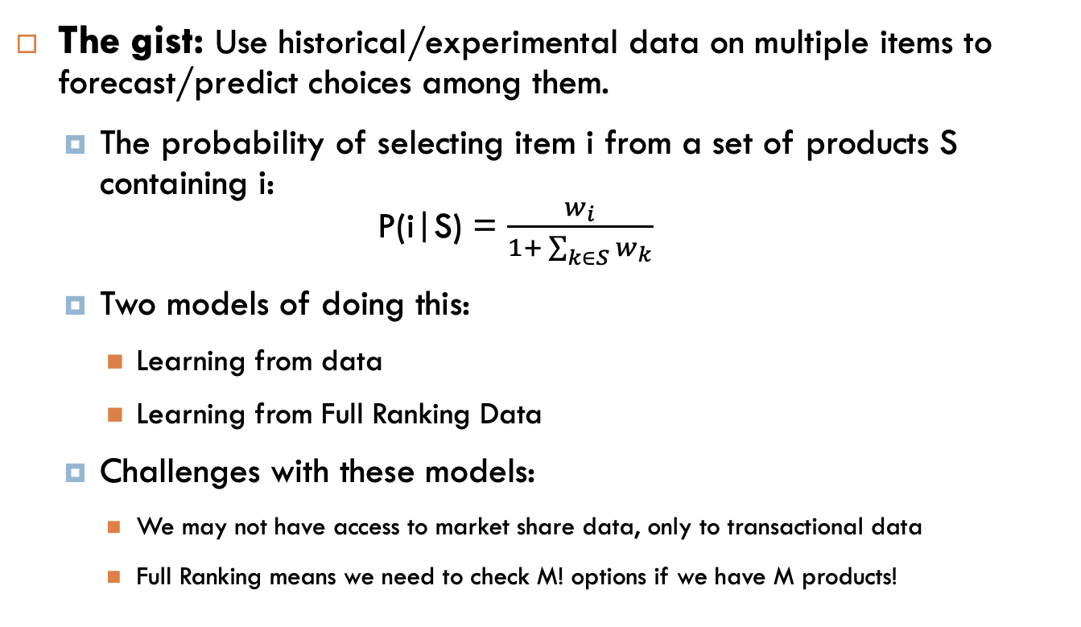
Choice Models-Review
The gist: Use historical/experimental data on multiple items to forecast/predict choices among them.
The probability of selecting item i from a set of products S containing i: P(i|S) = $\frac{w_{i}}{1+ \sum_{k∈S}{w_{k}}}$
Two models of doing this:
Learning from data
Learning from Full Ranking Data
Challenges with these models:
We may not have access to market share data, only to transactional data
Full Ranking means we need to check M! options if we have M products!
Notes:
Write formulas on the board before class

Slide 5
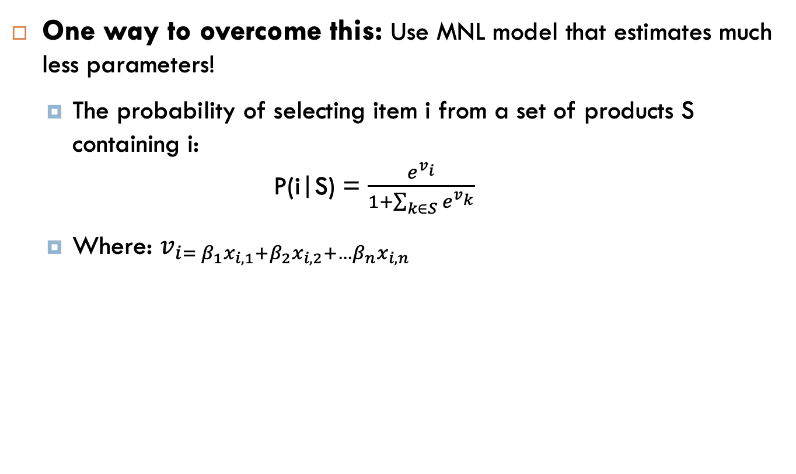
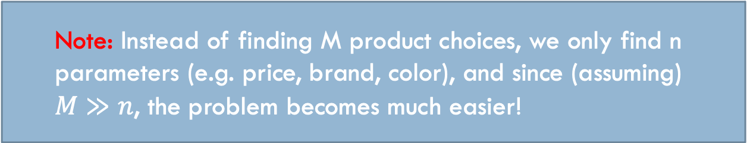
Multinomial Logit Model
One way to overcome this: Use MNL model that estimates much less parameters!
The probability of selecting item i from a set of products S containing i: P(i|S) = $\frac{e^{v_{i}}}{1+\sum_{k∈S}{e^{v_{k}}}}$
Where: $v_{i= β_{1}x_{i,1}+β_{2}x_{i,2}+{…β}_{n}x_{i,n}}$
Note: Instead of finding M product choices, we only find n parameters (e.g. price, brand, color), and since (assuming) $M≫n$, the problem becomes much easier!
Notes:
Write formulas on the board before class

Slide 6
Jumping to R!
Notes:
Write formulas on the board before class

Slide 7
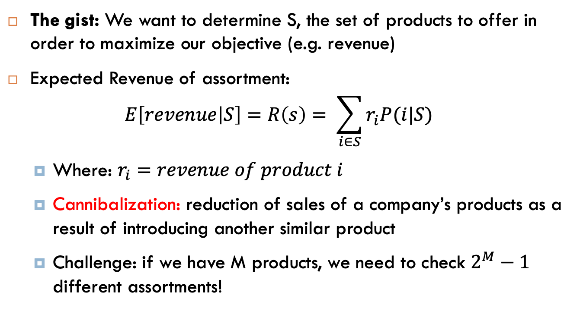
Assortment Optimization
The gist: We want to determine S, the set of products to offer in order to maximize our objective (e.g. revenue)
Expected Revenue of assortment: $E\left[revenue | S\right]=R\left(s\right)= \sum_{i∈S}{r_{i}P(i|S)}$
Where: $r_{i}=revenue of product i$
Cannibalization: reduction of sales of a company’s products as a result of introducing another similar product
Challenge: if we have M products, we need to check $2^{M}−1$ different assortments!
Notes:
Write formulas on the board before class

Slide 8
Finding Optimal Assortment Using MNL
An idea: Adding a popular but with relatively low revenue product will cannibalize our total revenue
Revenue Order (RO) Assortment has the top most expensive items
Greedy algorithm:
Calculate expected revenue R(S) for each RO assortment
Choose the RO assortment with the highest revenue
Can we optimize further?
Nested MNL/Personalized Assortments
Various other ways!
Notes:
Write formulas on the board before class

Slide 9
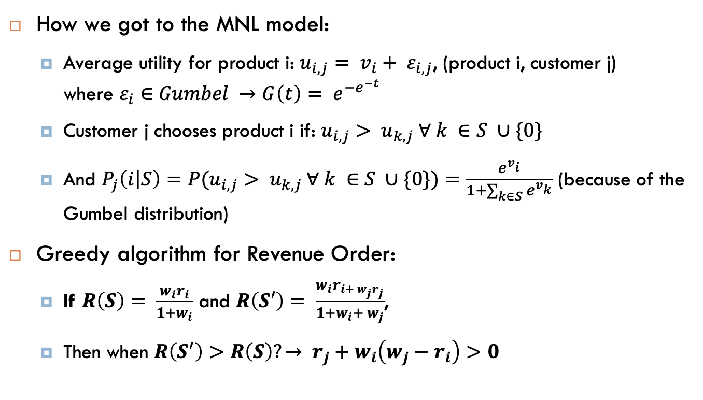
Appendix
How we got to the MNL model:
Average utility for product i: $u_{i, j}= v_{i}+ ε_{i, j}$, (product i, customer j) where $ε_{i}∈Gumbel →G\left(t\right)= e^{{−e}^{−t}}$
Customer j chooses product i if: $u_{i,j}> u_{k,j} ∀ k ∈S ∪\{0\}$
And $P_{j}\left(i | S\right)={P(u}_{i,j}> u_{k,j} ∀ k ∈S ∪\{0\})=\frac{e^{v_{i}}}{1+\sum_{k∈S}{e^{v_{k}}}}$ (because of the Gumbel distribution)
Greedy algorithm for Revenue Order:
If $R\left(S\right)= \frac{w_{i}r_{i}}{1+w_{i}}$ and $R\left(S′\right)= \frac{w_{i}r_{i+ w_{j}r_{j}}}{1+w_{i}+ w_{j}}$,
Then when $R\left(S^{′}\right)>R\left(S\right)?→ r_{j}+w_{i}\left(w_{j}−r_{i}\right)>0$
Notes:
Write formulas on the board before class

